Slide 1
Introducing the JSON Data Type in Azure SQL Database
Native JSON Processing in SQL Server
Edward Pollack
Microsoft Data Platform MVP

Slide 2
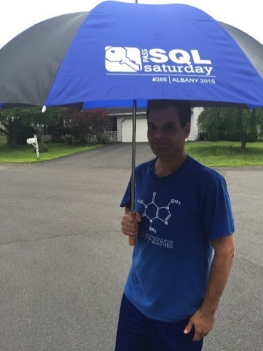






Ed Pollack
Microsoft Data Platform MVP
Published author of:
Dynamic SQL: Applications, Performance, and Security, 2nd Edition
Analytics Optimization with Columnstore Indexes in SQL Server
Published in Expert T-SQL Functions in SQL Server, 3rd Edition
Expert Performance Indexing in SQL Server, 4th Edition
Author on Simple Talk.
Organizes:
SQL Saturday New York City
SQL Saturday Albany 2024
Future Data Driven
Capital Area SQL Server User Group
Speaker at many data events
Find me on: LinkedIn

Slide 3
Agenda
JSON challenges
The new JSON data type
When to (or when not to) use it
That was great!

Slide 4

JSON in SQL Server: A Brief History

Slide 5
Challenges of JSON in SQL Server
SQL Server is optimized for data that is:
Relational
Structured
Made of rows/columns
JSON is:
Unstructured
Non-relational
Document-based

Slide 6
Why do we do this!?

Slide 7


How We Used to Store JSON in SQL Server

Slide 8
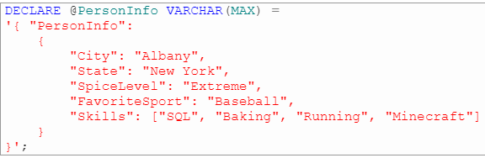
JSON as Strings
Challenging to index/optimize
Relies on string manipulation to parse
Consumes a lot of space

Slide 9
JSON in SQL Server (Classic)
Demo

Slide 10
The JSON Data Type
Added to Azure SQL Database in May, 2024
Still in preview as of 10/19/2024 (right now).
Provides native support for JSON documents
Uses less space / better performance.
In all compatibility levels
Requires no code changes!
No native JSON indexes (yet) but can be INCLUDE columns in indexes.

Slide 11
JSON in SQL Server (Native JSON)
Demo

Slide 12
Conclusion
Native JSON > strings.
No code changes needed!
Uses less storage/memory
Better performance
Hopefully coming to on-premises SQL Server soon.
Use it if you need it!

Slide 13
Thank You!
Find me here:
ed@edwardpollack.com
Ed Pollack | LinkedIn
Find my content here:
EdwardPollack (Ed Pollack) (github.com)
Edward Pollack, Author at Simple Talk (red-gate.com)
Ed Pollack, Author at SQL Shack - articles about database auditing, server performance, data recovery, and more

